Slide 1
Amaze_IITHyderabad
Team Members: Shagun, Manan Patel

Slide 2
Contents
Problem statement and scope of our innovation
Working backwards from customer and define who is your customer
Our success metrics and the impact of our solution
Scope for scalability and marketplace domain expansion
Architecture
Tech stack

Slide 3
Problem Statement and scope of innovation
Theme 4: Personalized Payment Experiences and Financial Management
Chatbot for Payment Queries
Customers experience frustration when dealing with payment-related issues due to long wait times esp. during holidays/festive seasons
Need of providing quick, accurate, and personalized assistance
Reading FAQs is boring and is not personalized as per customer’s situation/ order
Automated Budgeting and Financial Tracking
Many customers struggle to manage their finances effectively, often exceeding their budget limits and lacking a clear understanding of their spending habits.
need for an automated budgeting solution that allows customers to set annual purchase limits, receive notifications when they reach spending thresholds, and track their savings and expenditures across different categories on a yearly, monthly, and overall basis, promoting better financial health and control.
AI-Generated Payment Recommendation Engine
Customers face challenges in choosing the most advantageous payment method for each purchase
An AI-generated recommendation engine is required to suggest the best payment method for each customer purchase by analysing past payment history, current success rates, available cashbacks, and the costs of different payment options, thereby optimizing customer savings and convenience.

Slide 4
Solution
AI-Powered Chatbot for Payment Queries
Immediate Assistance: reducing customer frustration and wait times, especially during peak periods like holidays and festive seasons.
Enhanced Customer Satisfaction: By offering a user-friendly, conversational interface, our chatbot improves customer satisfaction and operational efficiency, reducing the need for manual intervention.
Personalized Service: Unlike static FAQs, our chatbot delivers tailored solutions based on each customer’s specific situation or order, significantly enhancing the user experience.
Automated Budgeting and Financial Tracking
Proactive Budget Management: Allows customers to set annual purchase limits and receive timely notifications as they approach these limits, helping them stay within their budget and avoid overspending.
Comprehensive Financial Insights: Tracks savings and expenditures across different categories on a yearly, monthly, and overall basis, providing clear and actionable insights into their spending habits.
Improved Financial Health: Encourages better financial control and health by promoting awareness of spending patterns and assisting in setting financial goals.
Intelligent Notification Triggers: Our system automatically triggers notifications when users approach their spending thresholds, ensuring they are always aware of their financial standing.
AI-Generated Payment Recommendations
Optimized Payment Choices: Our recommendation engine analyzes past payment history, success rates, available cashbacks, and costs to suggest the most beneficial payment method for each transaction.
Customer Savings and Convenience: By providing tailored payment suggestions, we help customers save money and enhance their payment experience, aligning with Amazon’s customer-first approach.

Slide 5
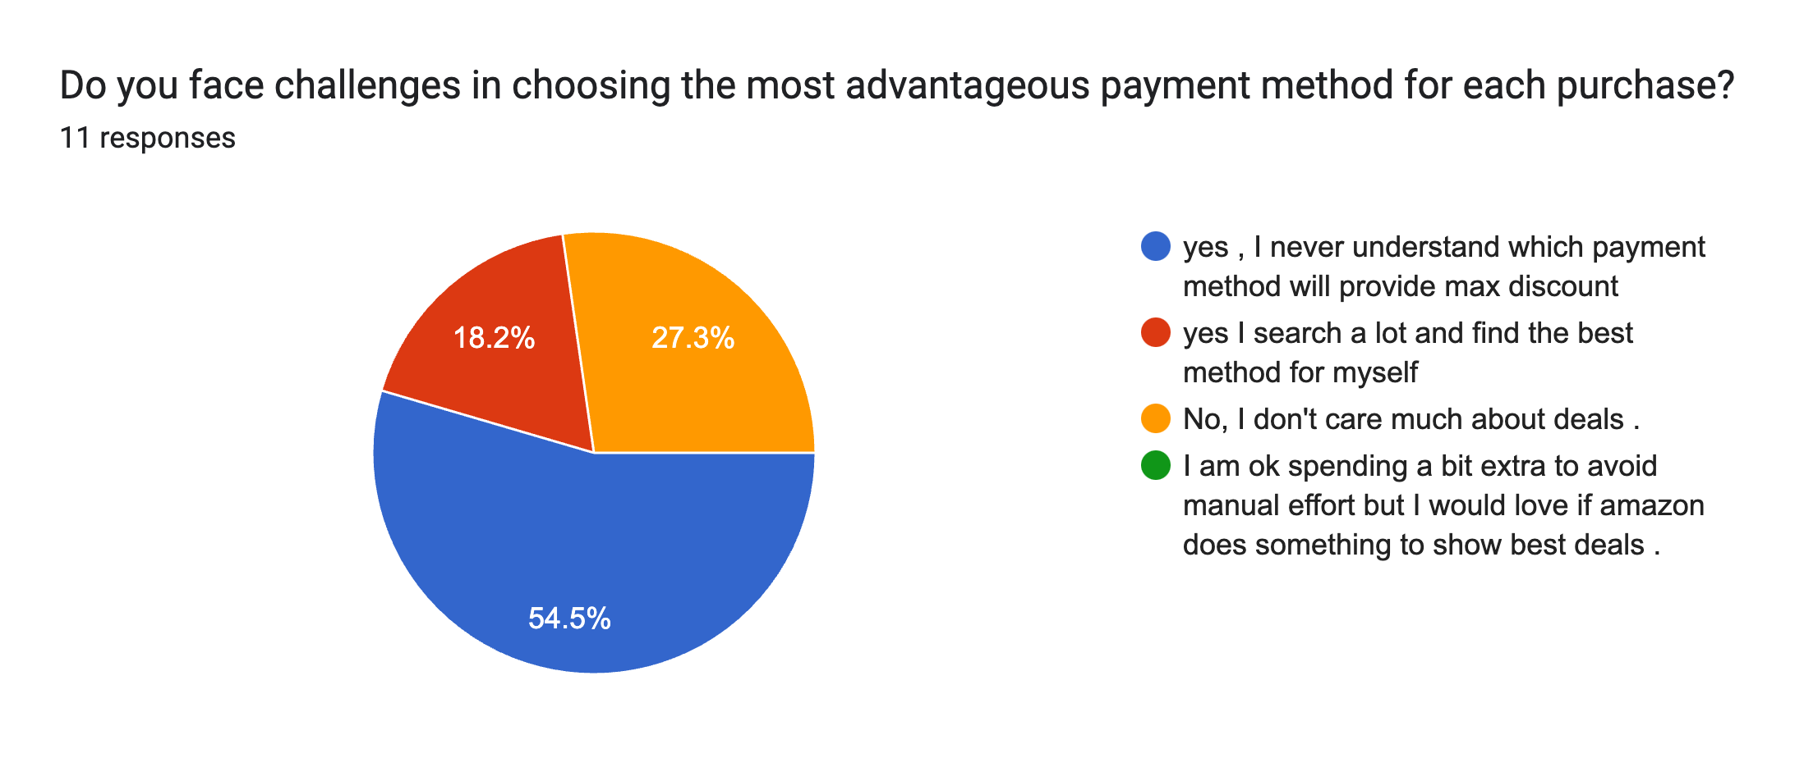
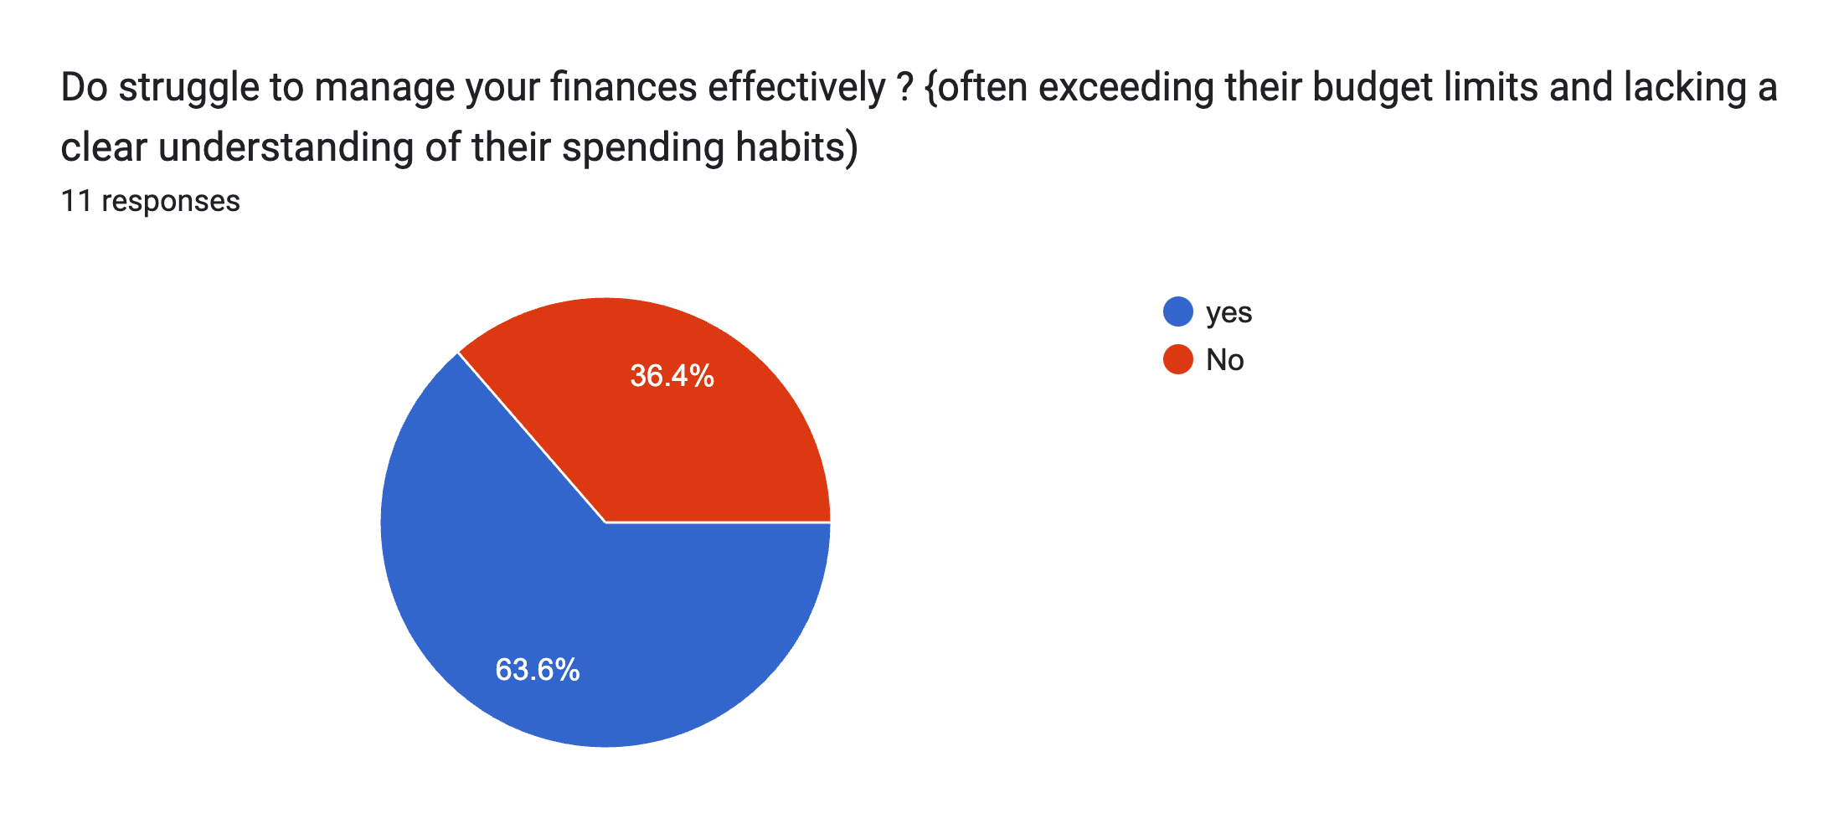
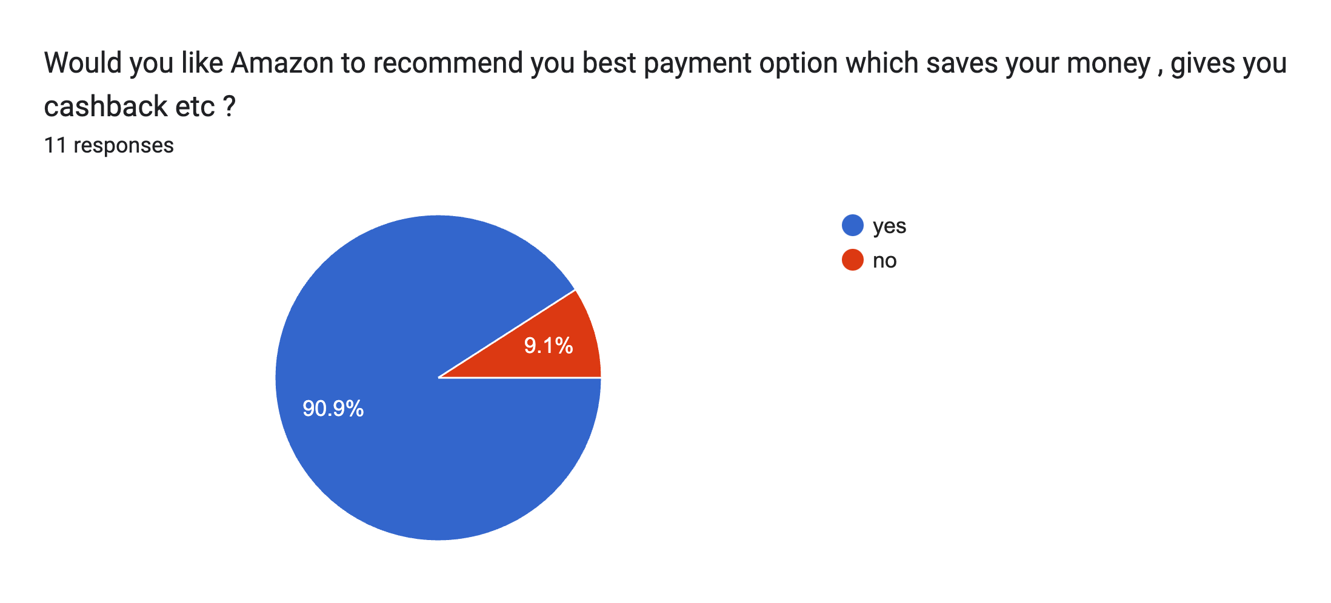
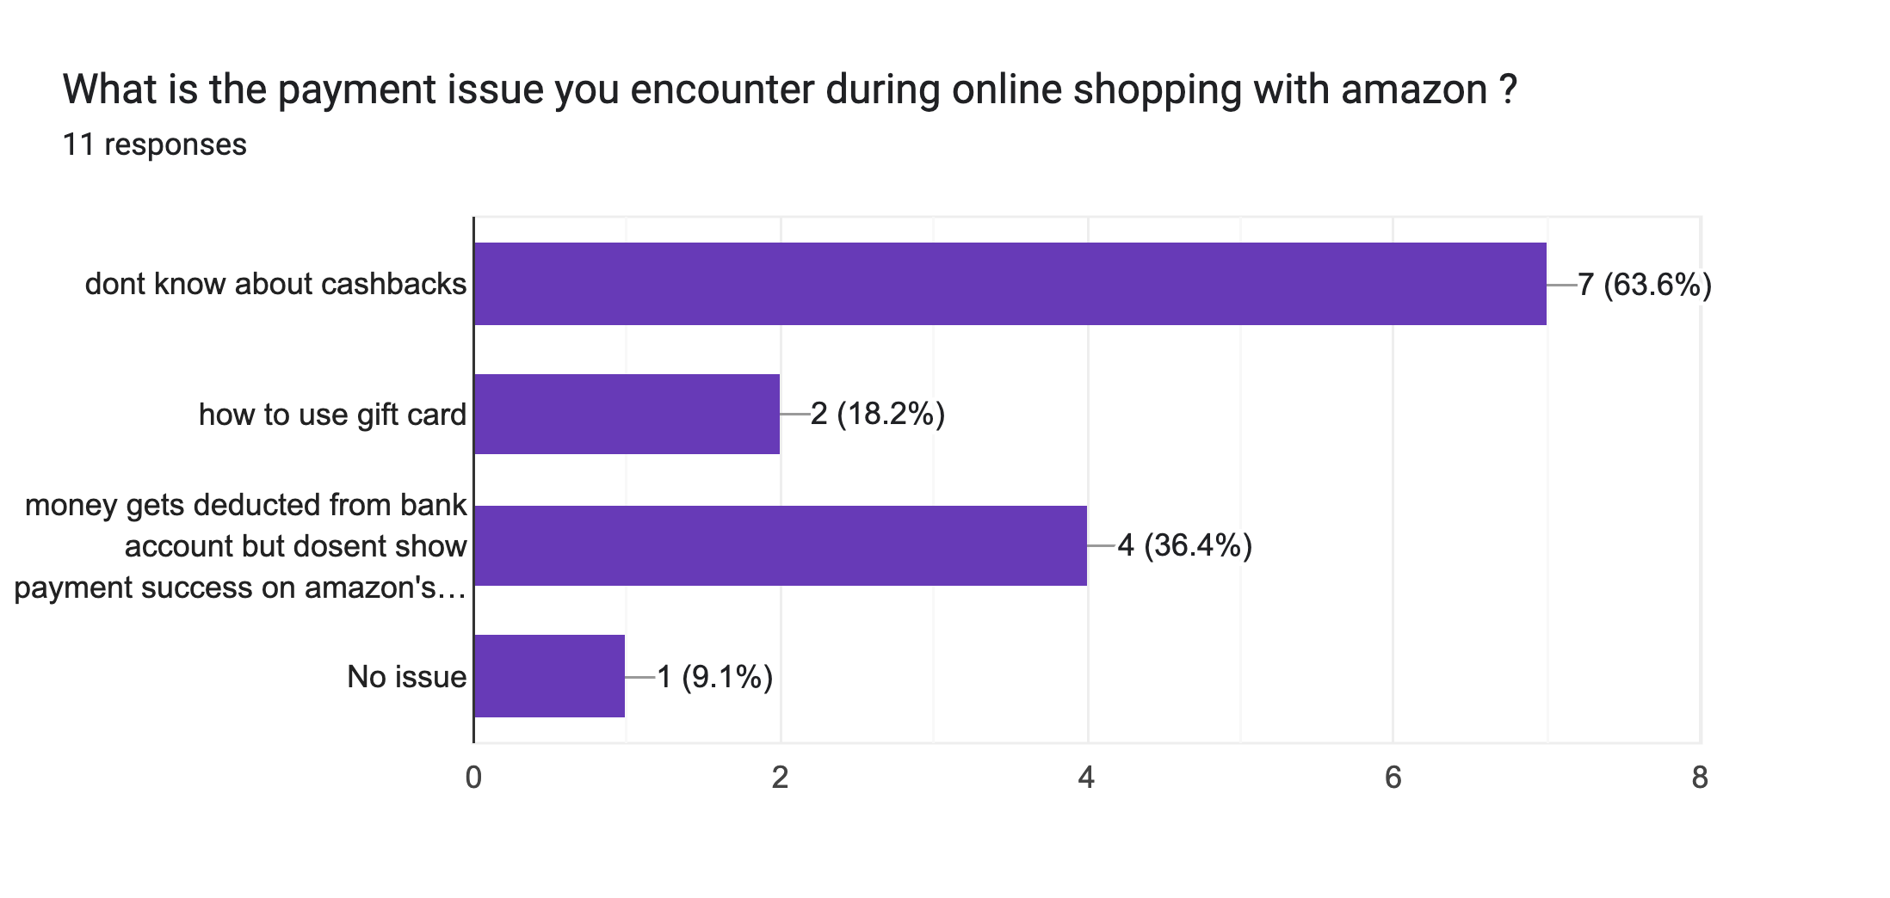
Customer Survey

Slide 6

Who is our Customer?
Tech-savvy individuals who prefer managing their finances digitally.
Parents who wish have a set budget set for their kids so they may learn budgeting and avoid overspending
Customers looking for personalized and efficient ways to handle their payments and budget.
Individuals interested in optimizing their payment methods for better savings and convenience.

Slide 7
Success Metrics
Customer Satisfaction:
Improvement in customer satisfaction scores (CSAT) related to payment queries and overall financial management experience.
Reduction in the average response time for customer payment queries.
Engagement and Usage:
Number of active users utilizing the AI-powered chatbot and automated budgeting tools.
Frequency of use of the payment recommendation engine by customers.
Financial Outcomes:
Percentage of customers staying within their set budget limits.
Amount of money saved by customers through optimized payment recommendations and budgeting tools.
Operational Efficiency:
Decrease in the volume of manual support queries related to payments.
Increased accuracy and relevance of payment recommendations provided by the AI engine.

Slide 8
Impact of the Solution
Enhanced Customer Experience:
Customers will experience a more streamlined, personalized, and responsive payment management process.
Improved financial literacy and budgeting among customers, leading to better financial health.
Operational Efficiency for Businesses:
Businesses can reduce their customer support costs and improve response times with the AI-powered chatbot.
Enhanced customer loyalty and satisfaction, leading to potential increases in customer retention and acquisition.
Optimized Financial Management:
Customers can make more informed and beneficial payment choices, leading to potential savings and optimized spending.
Automated budgeting tools can help customers avoid overspending and meet their financial goals more effectively.

Slide 9
Scalability and marketplace domain expansion
Scalability
Multi-Language Capability:
OpenAI supports a variety of languages, enabling us to serve diverse customer demographics effectively.
Robust and Scalable Infrastructure:
We leverage cutting-edge technologies like Node.js and AWS Lambda, providing the agility and scalability required to handle growing user bases and peak activity periods seamlessly.
Our use of highly scalable databases such as DynamoDB and MongoDB ensures efficient data management and system performance as we scale.
Marketplace Domain Expansion
Enhanced Customer Experience Across Domains:
AI-Powered Payment Solutions: Beyond handling payment queries, we can extend our AI-driven capabilities to offer personalized financial recommendations, aiding customers in making optimal payment choices and improving their financial well-being.
Automated Budgeting Tools: Expanding the current offering to include detailed budgeting and financial tracking, helping customers manage their spending and savings more effectively. This aligns with Amazon’s mission to simplify customer experiences and enhance financial literacy.

Slide 10
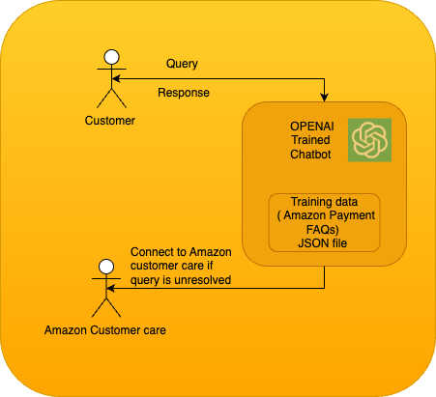
Architecture for AI powered chatbot service

Slide 11
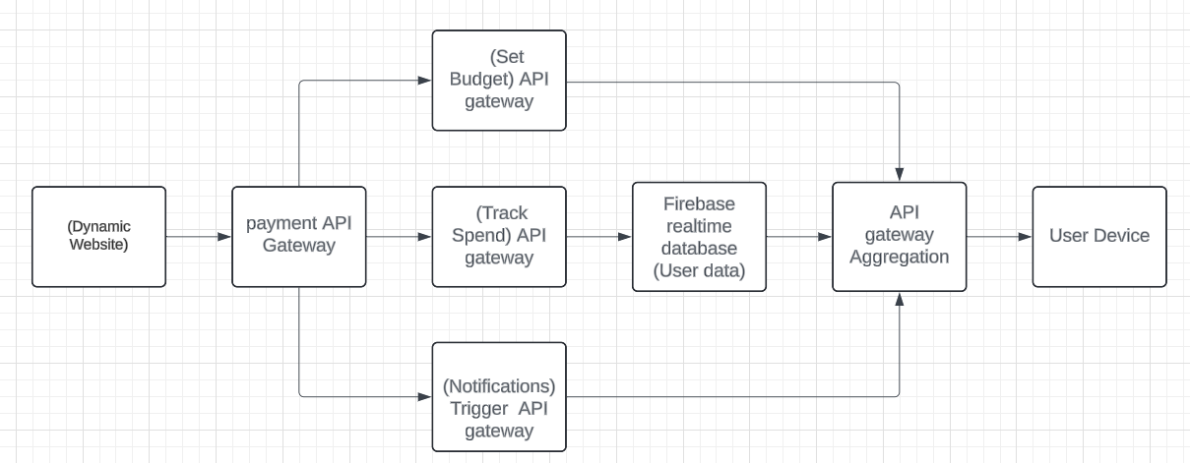
Architecture for automated budgeting solution

Slide 12
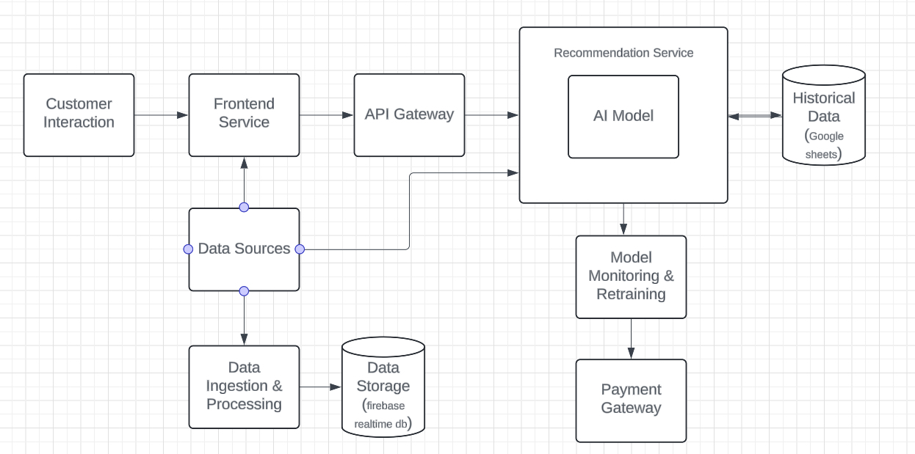
Architecture for payment mode recommendation

Slide 13
Tech Stack
Backend: Node JS , Flask, Express JS
Frontend: Next JS
Database: Firebase Realtime database, Google sheets, Redis
LLM Model: OpenAI
Cloud service: AWS EC2 instance

Slide 14
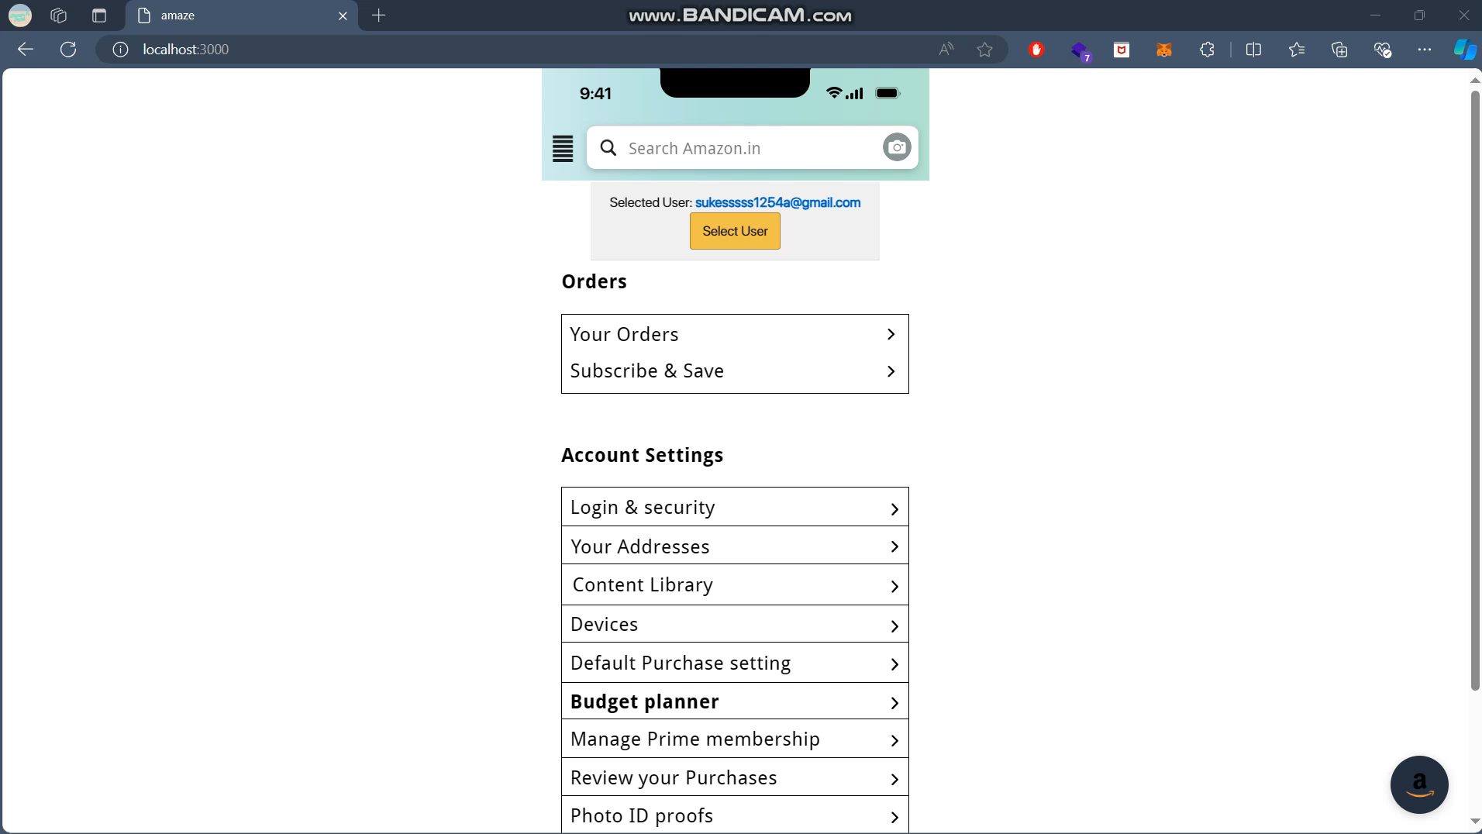

Slide 15


